Slide 1
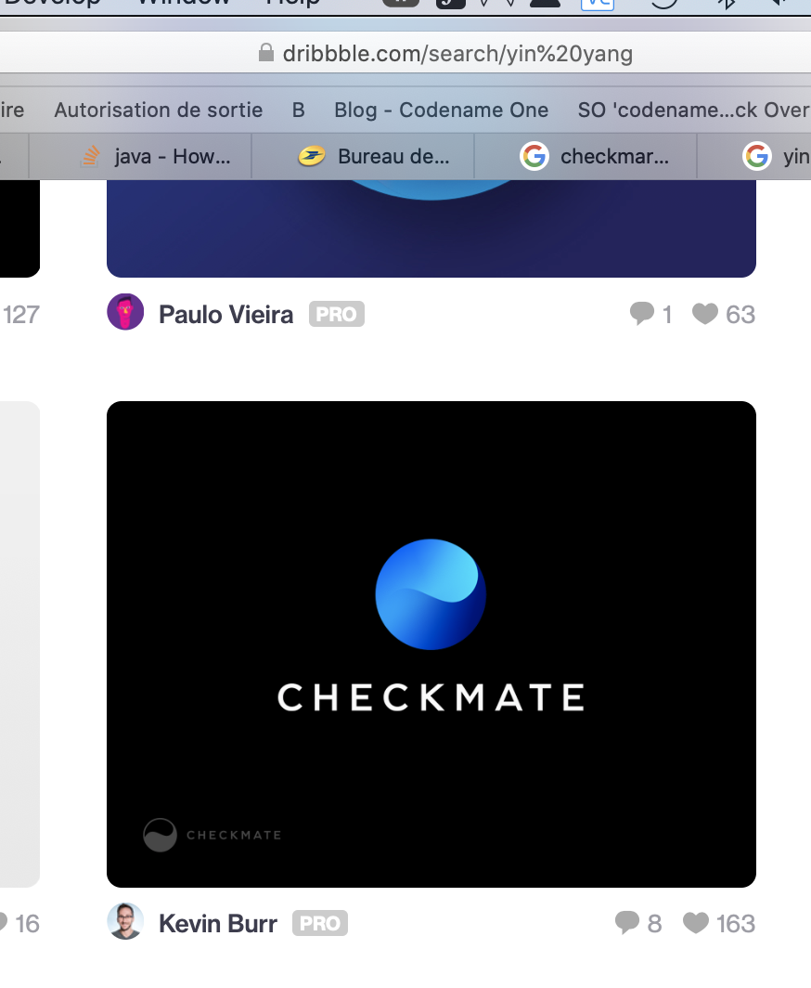



Slide 2
Specificiations
Business users, so eg solid colors
Pro-looking, so simple and essential
Subtle
Yin Yang or similar, signaling mastership, calm, stress-free, professionalism, predictability, transformation to something better/continuous improvement
Elegant

Slide 3







Slide 8
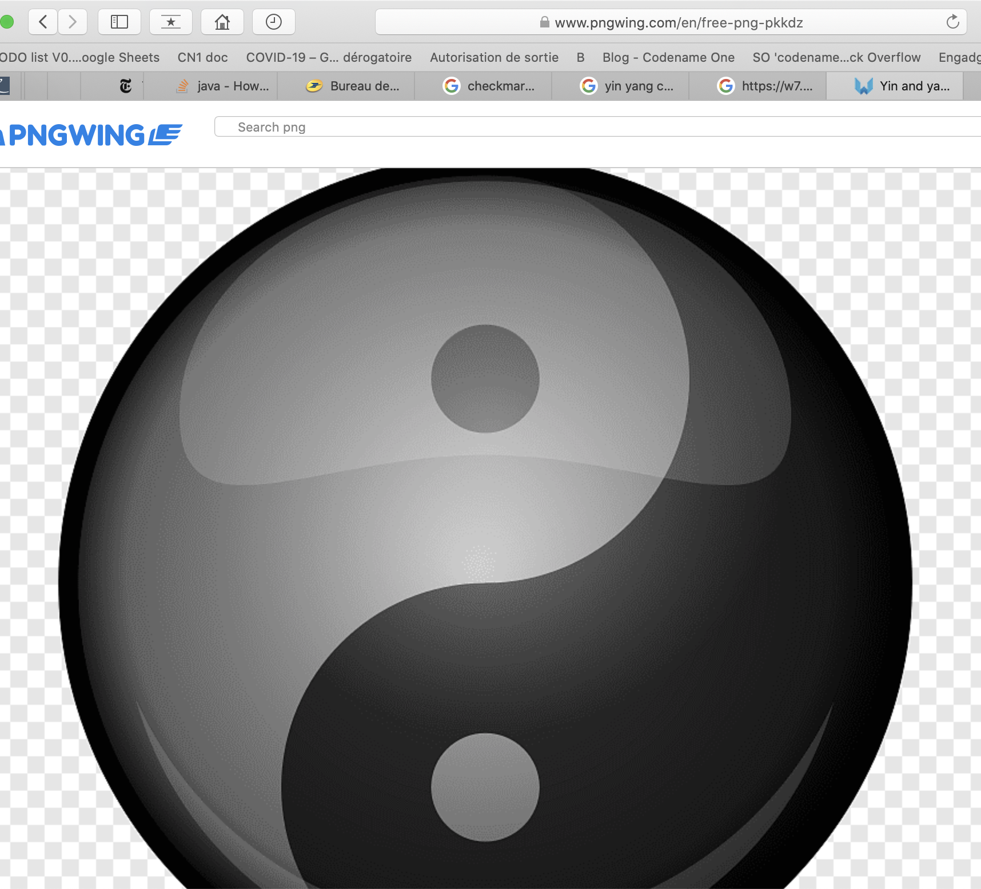

Slide 9
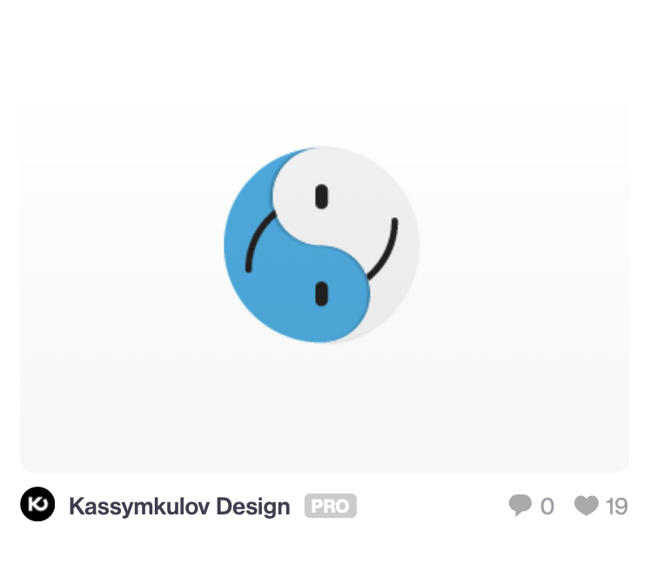
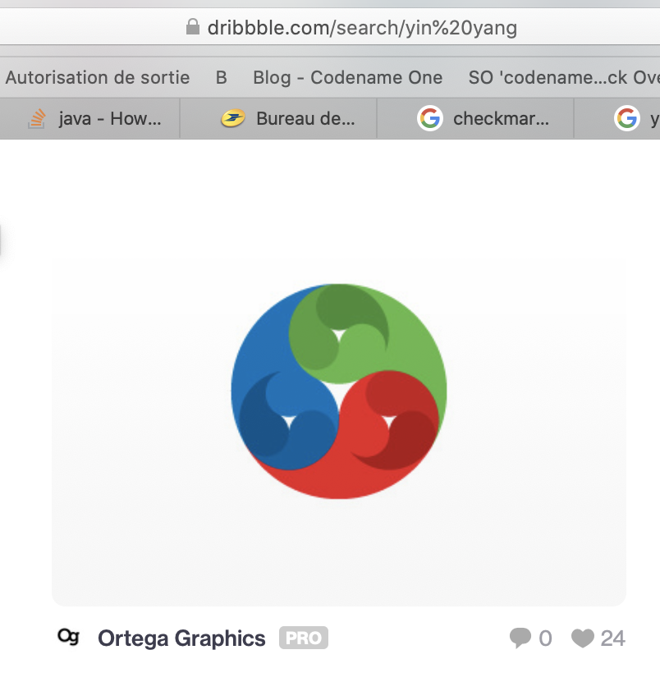
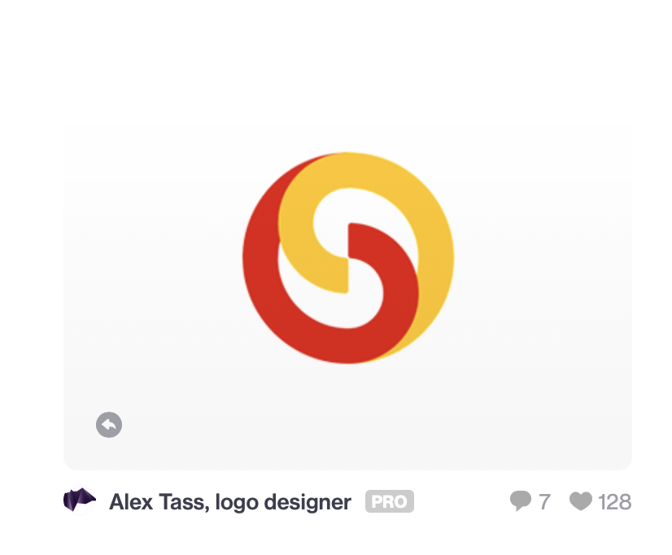
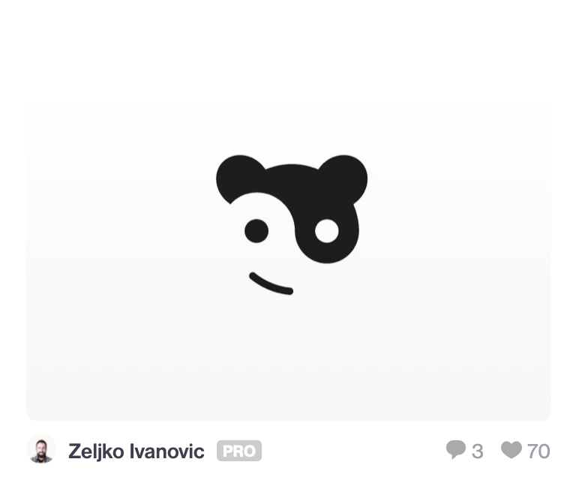

Slide 10
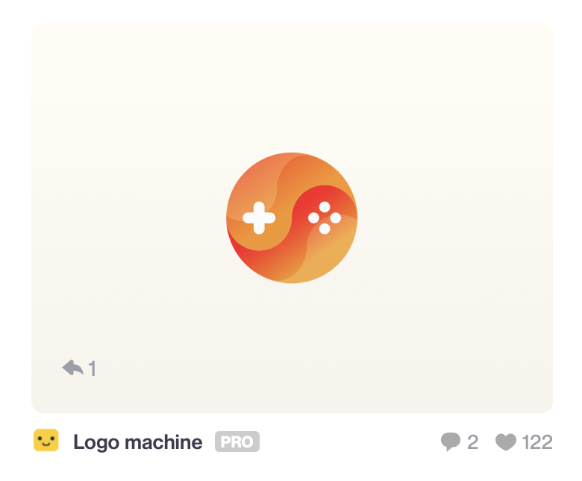
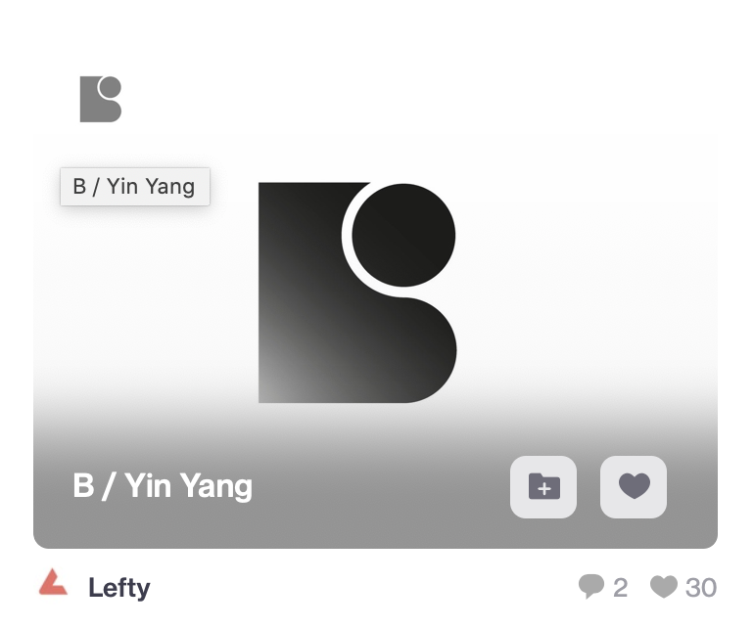

Slide 11




